Slide 1

Song Analysis

Slide 2
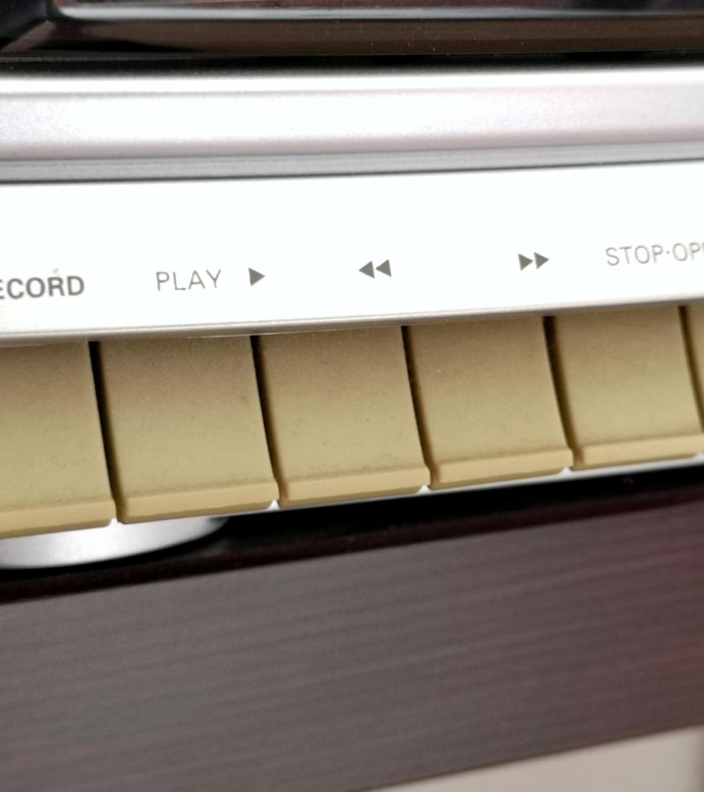
Problem lkmlStatement
♪
This internship project aims to conduct a comprehensive analysis of YouTube songs data using Tableau.
The goal is to utilize Tableau to create insightful visualizations and reports that provide a deeper understanding of YouTube songs' performance, popularity, and user engagement. The analysis aims to uncover trends, preferences, and patterns in the data to aid content creators and stakeholders in optimizing their YouTube song content.

Slide 3

Project Objectives
♫
Data Cleaning and Preparation
Exploratory Data Analysis
Content and Channel Analysis
Temporal Trends
User Engagement Insights
♫
♫

Slide 4

Dataset
1. video_id: Unique identifier for each YouTube video.
2. channelTitle: Title of the YouTube channel publishing the song.
3. title: Title of the YouTube song video.
4. description: Description provided for the YouTube song video.
5. tags: Tags associated with the YouTube song video.
6. publishedAt: Date and time when the YouTube song video was published.
7. viewCount: Number of views received by the YouTube song video.
8. likeCount: Number of likes received by the YouTube song video.
9. favoriteCount: Number of times the YouTube song video has been marked as a favorite.
10. commentCount: Number of comments posted on the YouTube song video.
11. duration: Duration of the YouTube song video.
12. definition: Video definition or quality (e.g., HD, SD).
13. caption: Availability of captions for the YouTube song video.

Slide 5

Analysis and Insights

Slide 6


Song Analysis Dashboard

Slide 7

Insights and Recommendations
Vaaste Song Having this song part of the 3 top 10 we analysed, Top Views, Top Likes and Top Comments.
2018 and 2019 These years were the most consistent years by having the highest quantities of Views, Likes and Comments.
HD 16,583 Videos utilized High Definition, being this over 80% of the videos analysed.
Captions This is one of the things we should keep in mind when we are planning to reach international audiences.
HD Having High-quality Videos makes easier to catch user’s attention plus significant content will trigger to have more likes and comments.
Tags Play a critical role when comes to promoting content, and by using popular and relevant tags will therefore increase visibility and increase audiences.

Slide 8

Summary
If we are targeting to have more trending videos, we should have clear what is being relevant now a days, what people is looking more into. High quality videos, trending tags, eye catching content that will lead to more views and therefore more likes and comments, and by that an option to share with friends and make video more trending.

Slide 9

Thank You

